Slide 1
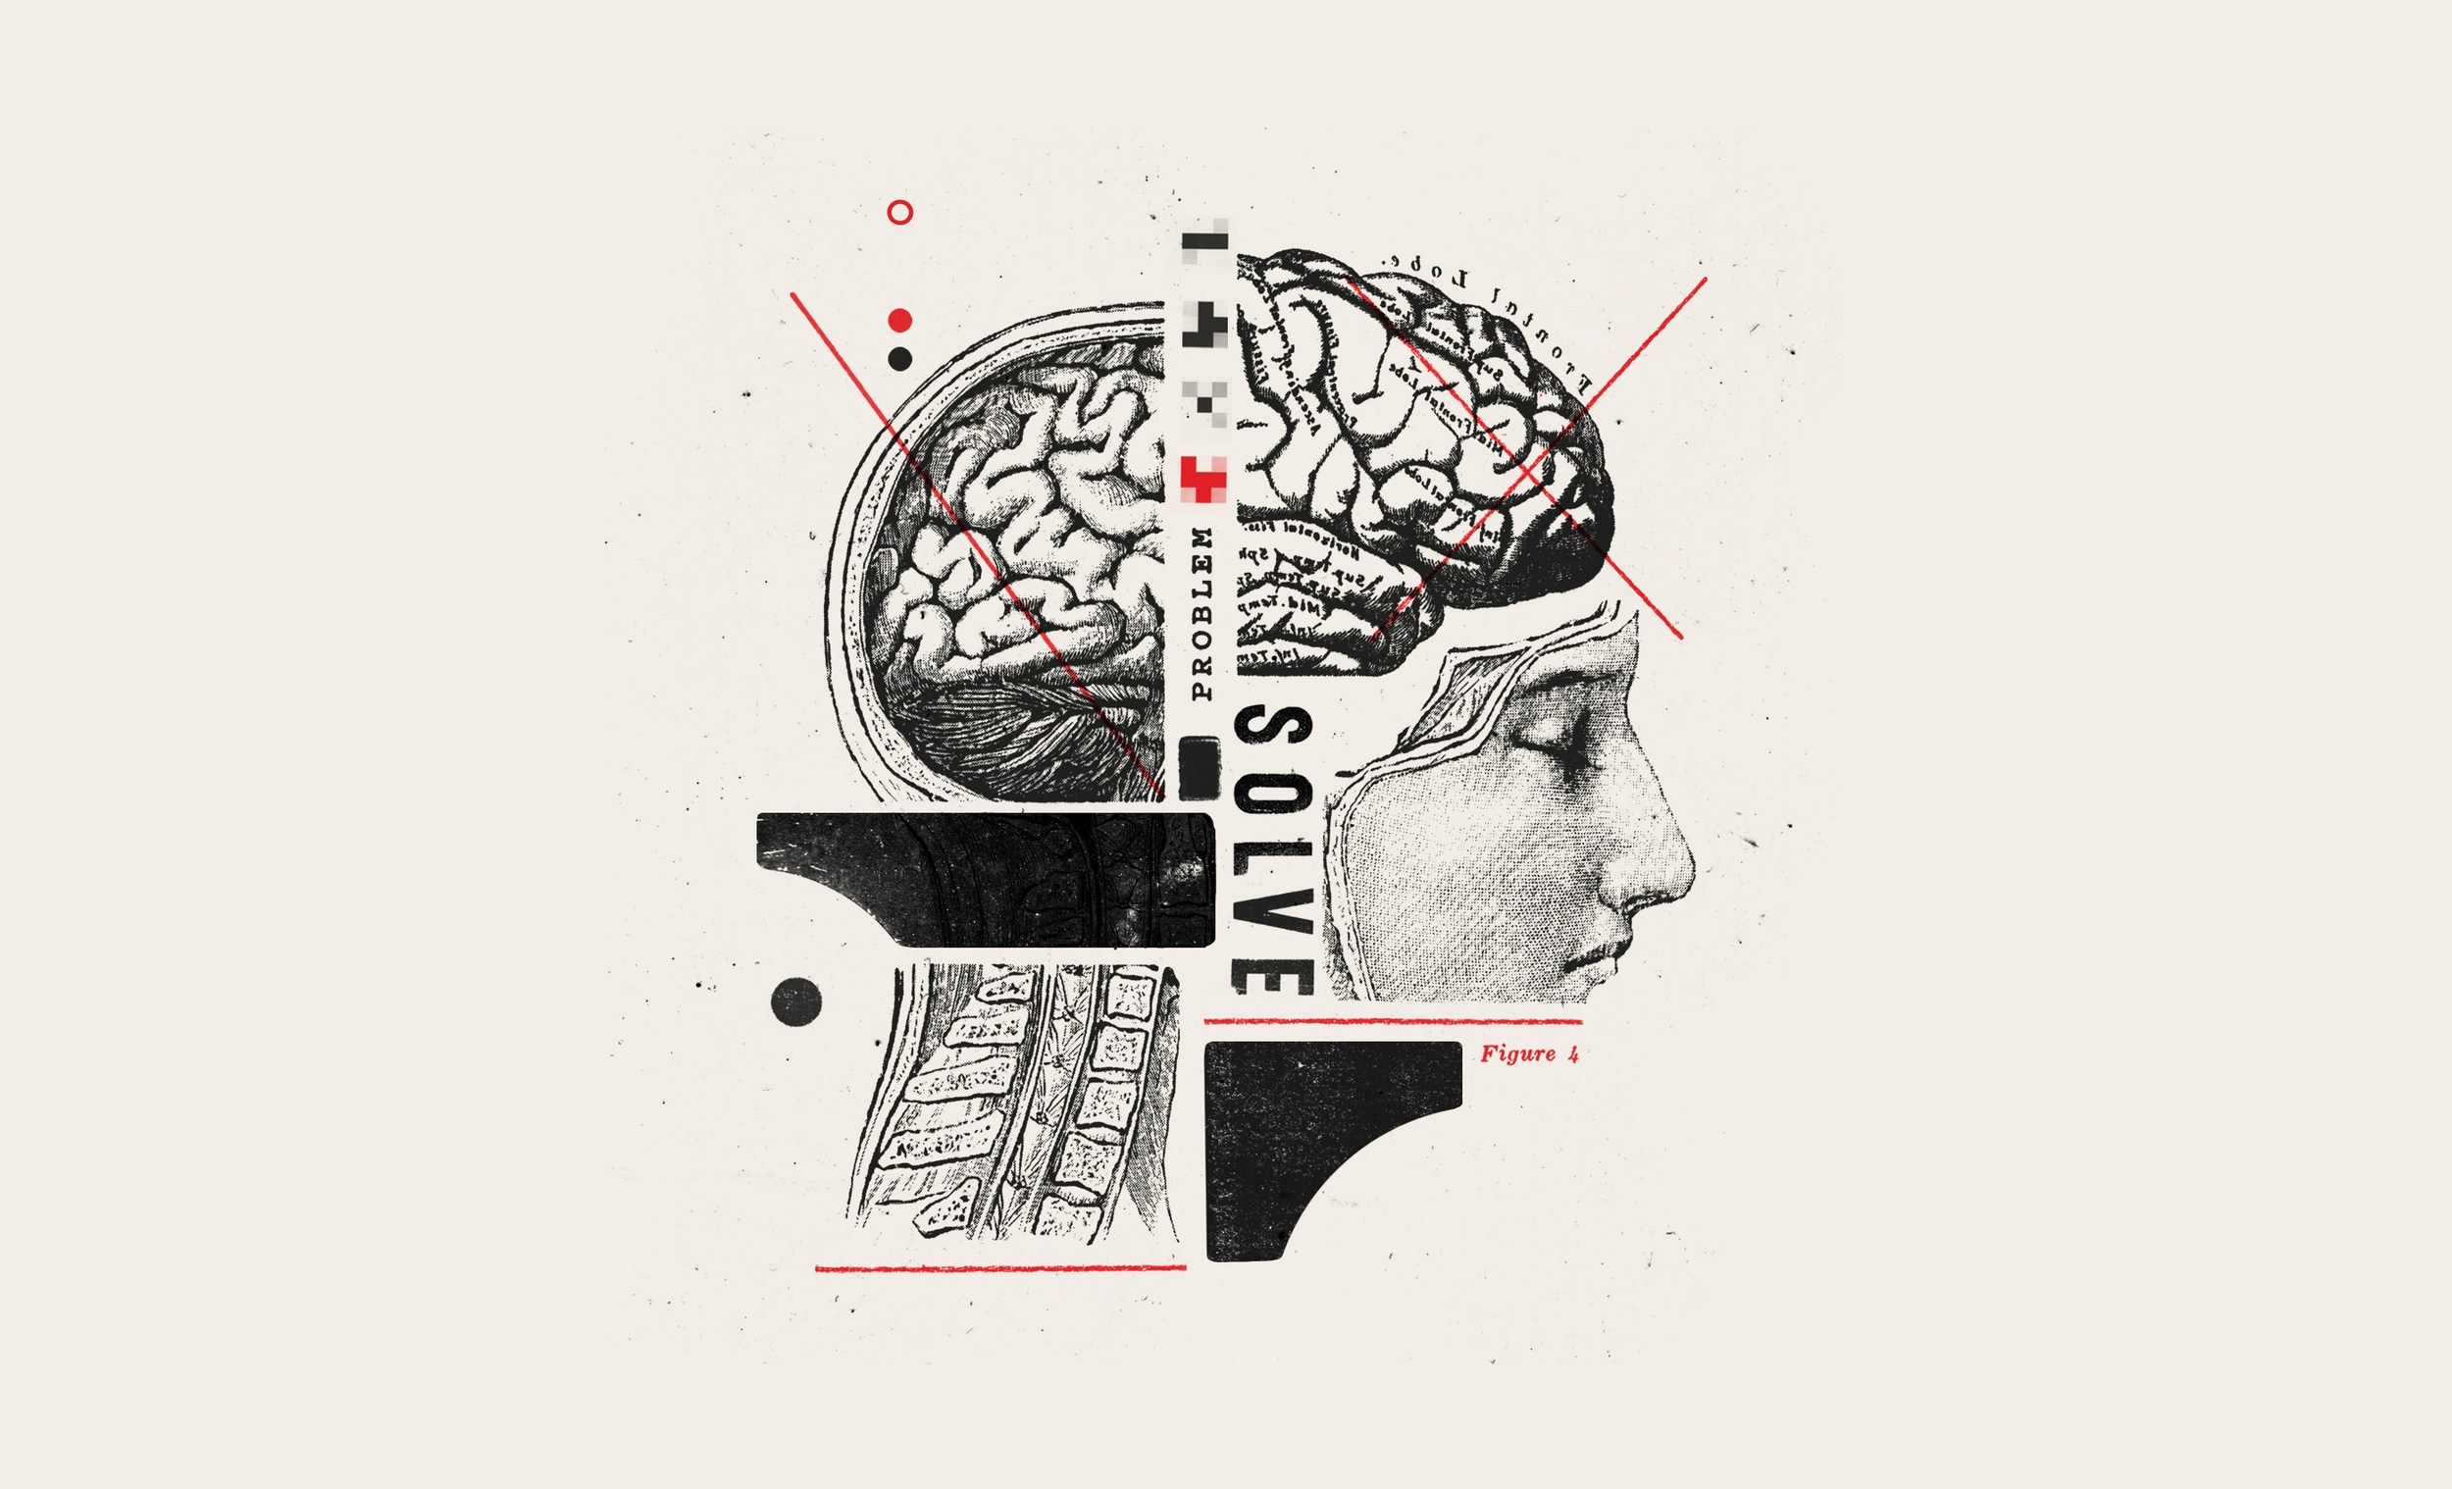
In 10 minutes
DESIGN
THINKING
by Ken Baldauf

Slide 2
Design Thinking
Four Pillars

Slide 3

Empathy
Design Thinking
Notes:
Understanding the issue from the users perspective.

Slide 4
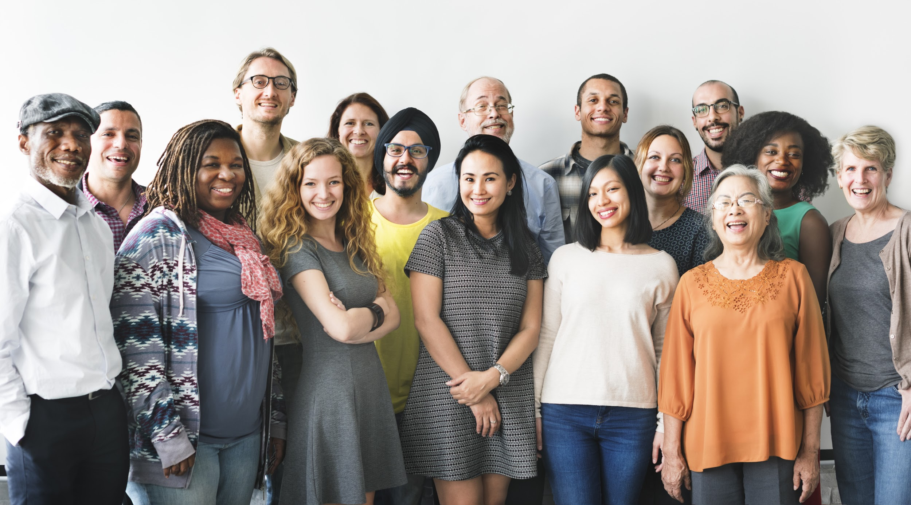
Collaboration
Design Thinking
Notes:
Appreciating a diversity if perspectives and skillsets. Can’t Design Think alone.

Slide 5

Inclusion
Design Thinking
Notes:
Every idea counts!

Slide 6
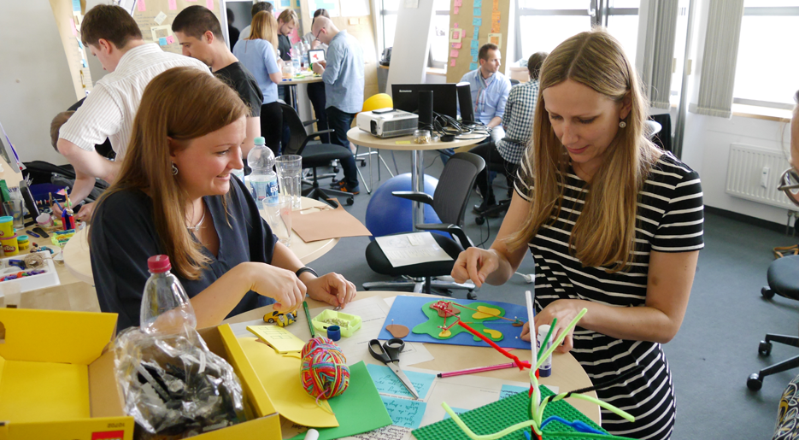
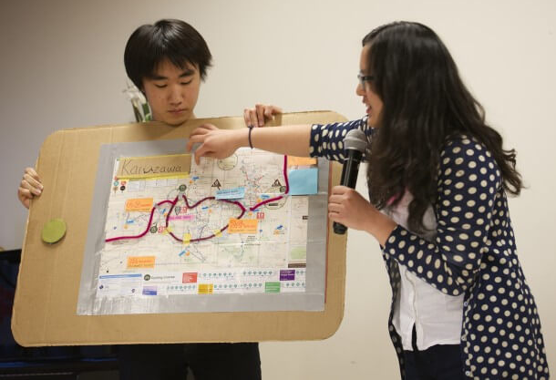
Repeat/Iterate
Design Thinking
Notes:
Getting ideas out into the open for evaluation. Getting user feedback.

Slide 7
Design Thinking
Empathize with people's needs,
Collaborate with others across disciplines, skill sets, and perspectives,
Include every idea in visible form for evaluation, and
Repeat, iterating and testing solutions to perfect them, always with human needs at the center.

Slide 8
Design Thinking Quiz
Design Thinking or NOT Design Thinking

Slide 9
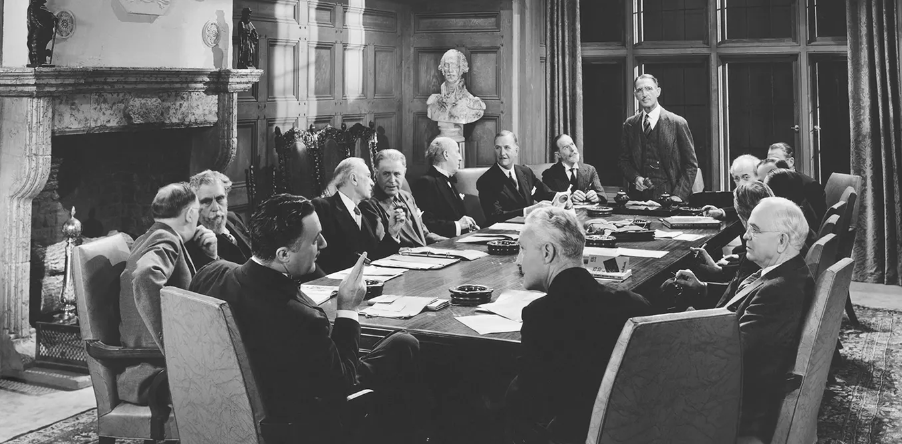

Slide 10
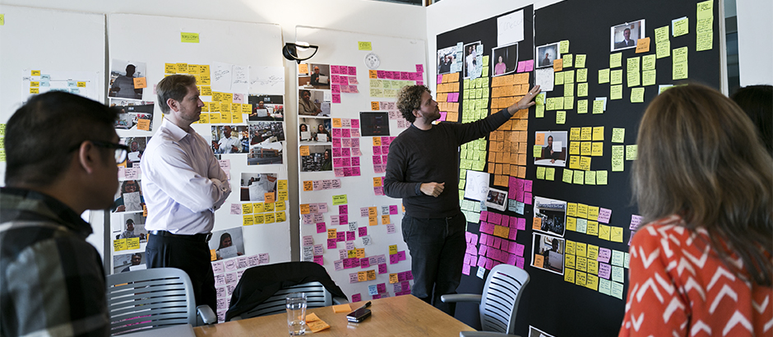

Slide 11
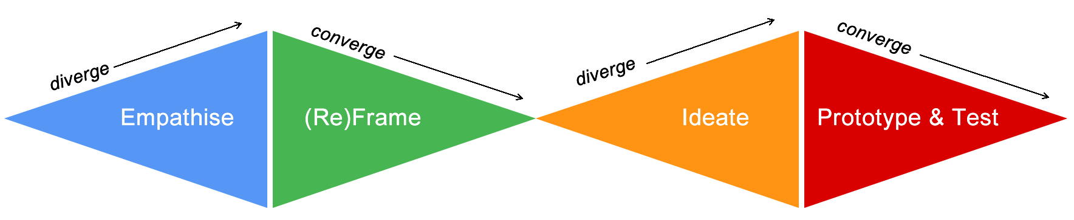
Design Thinking Process
P r o b l e m S p a c e
S o l u t i o n S p a c e
Design
Challenge
Design
Solution

Slide 12
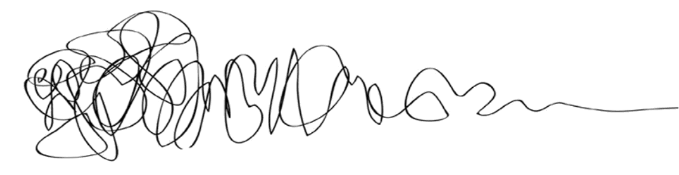
Design Thinking
P r o b l e m S p a c e
S o l u t i o n S p a c e
Design
Challenge
Design
Solution

Slide 13
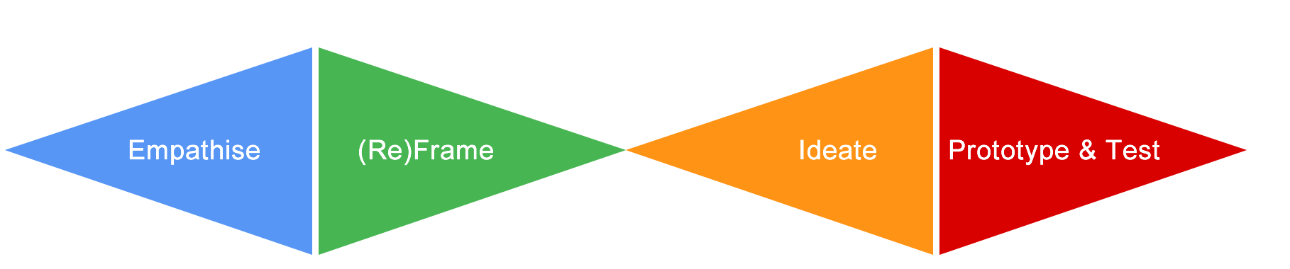
Design Thinking Branding
Design Thinkers Group
Empathize | (Re)frame | Ideate | Prototype | Test
Stanford d.school
Ideo
Ideo v2.0
Luma Institute
IBM
FSU Innovation Hub
Empathize | Define | Ideate | Prototype | Test
Gather | Generate | Make | Share
Inspiration | Ideation | Implementation
Looking | Understanding | Making
Observe | Reflect | Make
Empathize | Ideate | Build

Slide 14
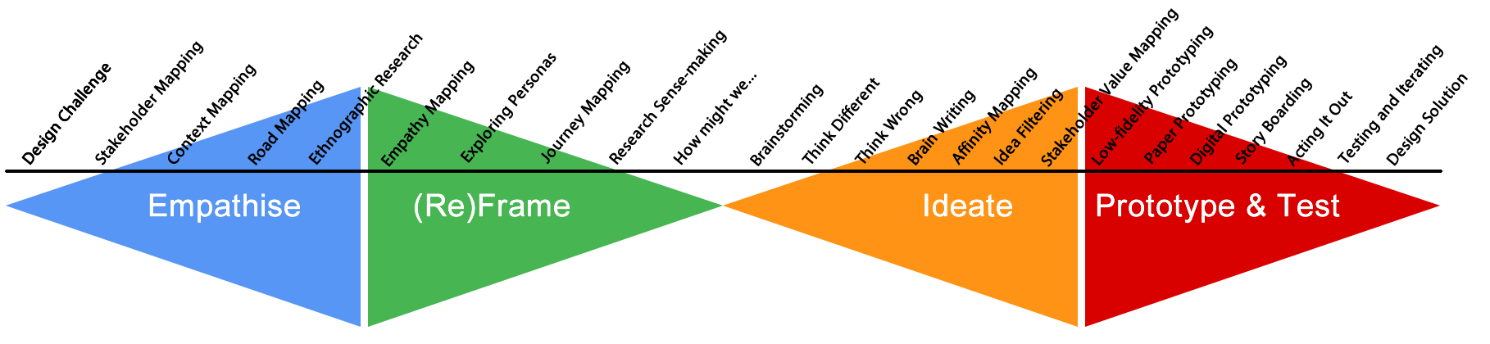
Design Thinking Methods & Tools
Design Thinkers Group
Stanford d.school
Ideo
Ideo v2.0
Luma Institute
IBM
FSU Innovation Hub
Empathize | (Re)frame | Ideate | Prototype | Test
Empathize | Define | Ideate | Prototype | Test
Gather | Generate | Make | Share
Inspiration | Ideation | Implementation
Looking | Understanding | Making
Observe | Reflect | Make
Empathize | Ideate | Build

Slide 15
Design Thinking Steps in Perspective

Slide 16

Design Thinking Steps in Perspective

Slide 17
Thank you!
www.innovation.fsu.edu
DESIGN
THINKING

Slide 18
Problem Statement
How might we improve the grocery shopping experience in a manner that positively impacts people and the environment?

